Slide 1

Mobile Application for non-invasive detection of haemoglobin (Hb) level using deep learning model
Presented by: Shoon Zhen Yong (U1920283L)

Slide 2
Table of contents
01
02
Background
Research Gap
03
04
Aim of Project
Conclusion

Slide 3


Background
01
Donation Requirements
Donation Attempts
>=12.5g/dL
>=13.0g/dL
32.25%
16.26%

Slide 4
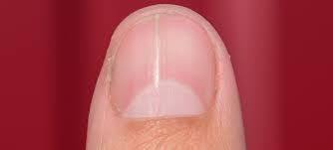
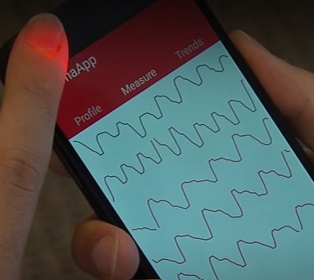
Research Gap
02
Performance Criteria
± 4%
 | Fingernail Bed | Fingers
Accuracy | 81.5% | 85.7%
Sensitivity | 97% | 76.5%

Slide 5



03
Aim of Project
Provides accurate haemoglobin level through deep learning models
Skip the Queue
Real-Time Blood Stock Update

Slide 6
04
Conclusion

Slide 7
Thanks !
Q&A Session

